Slide 1

PureLearn
Unlock your Learning Potential

Slide 2
Introducing Our Team

Slide 3
Selecting Methodologies & Underlying Principles
Software Engineering method, best practices & Process
Product Management Methodology
UX Process

Slide 4
Selecting Underlying Software Engineering Method & Process

Slide 5


Slide 6
Software products
Agile software engineering, features, scenarios and user stories.
software architecture
cloud-based software
DevOps and code management.

Slide 7
Software Product based vs Project based

Slide 8
Selecting Product Management Methodology

Slide 9
Agile Mindset

Slide 10
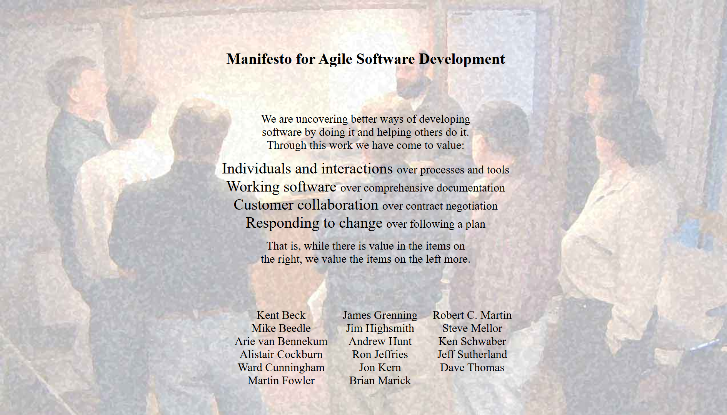

Slide 11
Scrum Framework
Agile has many frameworks

Slide 12
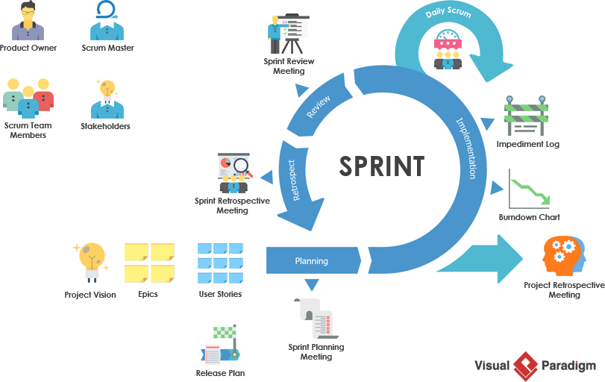

Slide 13
UX Process

Slide 14
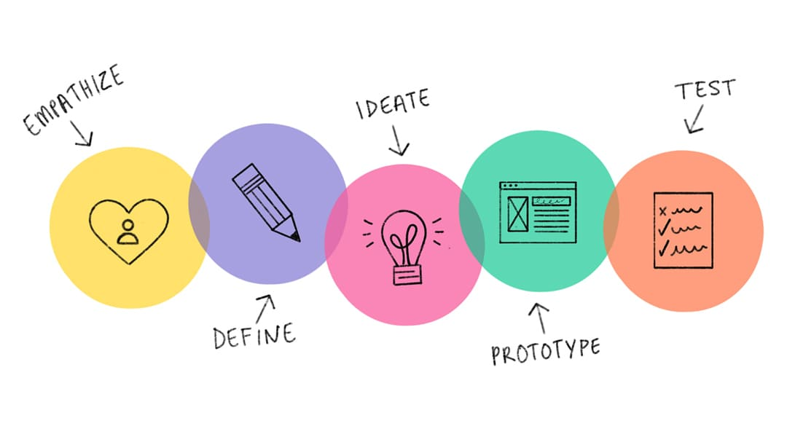
Notes:
طبعا وعشان احنا بنتبع اجايل ميند سيت ف اهم حاجه عندنا ان احنا نكون بنقدم فاليو للعميل فعلا ف عشان كدا لازم نمشي بخطوات الديزين ثينكينج عشان نوصل اليوزر لاحسن اكسبرينس ممكنه
اول حاجه فيها أي هي ايمبثايز ال احنا نحس باليوزر أي الحاجات ال بتضايقه عشان نشيلها، واي الفرص ال ممكن تزود من ارضاءه
ودي بتتعمل بميتنجس، سيرفايز او ان احنا نبص ع فيدباك ف جوجل بلاي ع سيملر برودكتس مثلا ونشوف أي الحاجات ال مضيقاهم واي الحاجات ال بسطاهم
بعد م قعدنا مع العميل بنبدأ ندفين الفرستراشنز والنيدز والاوبرشونتيزي بشكل كويس جدا وبنبدأ نستخدم حاجات اسمها بيرسوناز
ايديات بندأ نشوف حلول للمشاكل وأفكار للتنفيذ
بروتو تياب بنجرب حلول سريعه
بعدين بنعمل عليها تستنج مع الناس ونسألهم عن رأيهم لو تمام بندأ ننفذ ونحول البروتوتايبس دي لشكل مفصل
ف دا كله بيضمن لنا ان احنا نعمل حلول فعلا قريبه من اليوزر بشكل فعال ومريح له

Slide 15
Selecting Problem & Our Vision

Slide 16
We Select Self-Learning Process

Slide 17
Self-Learning Process
Background and self-learning in current era

Slide 18
Self-Learning Process
Why is it so important?

Slide 19
Self-Learning Process
Problems

Slide 20
Product Vision
What’s it? Why’s it important?

Slide 21
Vision statement
PureLearn is the ultimate self-learning management system, guiding individuals through a structured, goal-driven learning journey. By integrating all essential tools—goal setting, task management, progress tracking, and knowledge documentation—it eliminates distractions and enhances focus, allowing learners to stay organized, track their growth, and adopt best learning practices effortlessly.
Notes:
يور ليرن عباره كورس بلاتفورم ابليكشن بيشغل ك فريمورك فيه كل التولز واللرينينج بيست براكتسيز والبروسيس ال يحتاجها السيلف ليرنر ويمر منها عشان يحقق أهدافه المرجوه من السيلف ليرنينج.

Slide 22
Mission statement
Enable lifelong learners to adopt a sustainable, goal-oriented self-learning process by offering a tailored management framework that maximizes productivity, tracks progress and reinforces focus.
Notes:
Facilitating Self-learning process and making it sustainable
Supporting self-learners to
overcome their frustration
maximize their productivity.

Slide 23
Let’s Start our Journey of PureLearn Engineering Phases

Slide 24
1. Empathize
Desing Thinking& User-Centric Design
Notes:
عشان تحل المشاكل بشكل حقيقي و واقعي لازم تحتك باليوز بتاعك وتتعرف ع مشاكله والحاجات ال بتضايقه

Slide 25
Discussions with real people
Observing
Notes:
بتقابلنا صعوبات وتحديات كتير ف حكاية التعلم الذاتي، وعندنا طرق للتغلب عليها زي ان احنا بتنقل م بين الكورسات وتعلم المجالات عشان مش محددين اهداف واضحه انه يقدر يكويت بسهوله من الكورس وميكملوش لاخر وأول م يبدأ فيه يبدأ م الأول تاني عدم إدارة الوقت البرن اوت، انه هو ممكن يشد ع نفسه شهر ولا اتنين ويوقف 6 شهور ولا حاجه ان الوقت بيضيع ف السوشيال ميديا لو الواحد ساب نفسه ليها
وانا قاعد ف المواصلات
واحد ف كلية علوم عنده 27 شغال فرونت ايند، التعلم الذاتي غيرله حياته حتى لو بدأ ف وقت متأخر
واحد كان شغال ف شئون قانونيه ومتزوج 35 سنة وكان عايز يسوتش كارير وبدأ يتعلم عشان يدخل مجال تاني – كول سنتر
ان ف ابليكشن للبرودكتيفتي شكلها حلو وبسمسم بس ف الأخر مبتعملش حاجه

Slide 26
2. Define
Define Frustration & Needs
Notes:
بعد م نجمع معلومات بنعمل حاجه اسمها البيرسوناس، ودي بيبقو فيكشنال بيرسونز بيمثلو التارج يوزرز بالنسبالنا ونعرض أسماءهم ك تايتلز وبعدين ناخد مثال واحد

Slide 27
Personas
Fictional persons represent out users

Slide 28
Personas
LIFELONG LEARNER (PROFESSIONALS IN FAST-CHANGING FIELDS)
CAREER STARTER
CAREER SWITCHER
ACADEMIC STUDENT

Slide 29
Personas
CAREER STARTER
Basic info
Name: Amina Hassan Age: 22 Gender: Female Location: Cairo, Egypt Profession: New graduate – exploring UX/UI Design or Digital Marketing

Slide 30
Personas
CAREER STARTER — Amina Hassan
2. Quote: "There’s too much content everywhere. I need a quiet space to just focus and grow.“
3. Bio: Amina just finished university and feels excited but overwhelmed. She opens YouTube and ends up jumping between design tutorials, productivity hacks, and job search tips — ending the day drained with no real progress. She uses her phone for learning but gets constantly distracted by social media. Her goals feel blurry, and she doesn’t have a structure to turn curiosity into progress.

Slide 31
Personas
CAREER STARTER — Amina Hassan
4. Core Needs :
A step-by-step learning framework tied to clear goals
A distraction-free interface focused on clarity and habit-building
Gentle motivation through streaks, reminders, and visual feedback
5. Frustrations :
Always starting but never finishing learning paths
Lost in endless links and saved posts
No confidence in how to track or measure her skill development

Slide 32
3. Ideate
Generating Idea to solve problems & Satisfy the need.
Notes:
بعد كدا نبدأ ف الايداشن وهي الحلول ونبدأ نقسم الحلول بتاعنا لمحاور اساسيه وكبير وعامه اسمها الثيمز

Slide 33
Prompt
The start of brainstorming
1 | Break the self-learning process into phases and identify features to support each phase.
2 | Identify challenges and problems faced by self-learners.
3 | Identify best theories and practices to support self-learners and increase productivity.
4 | Analyze similar apps.

Slide 34
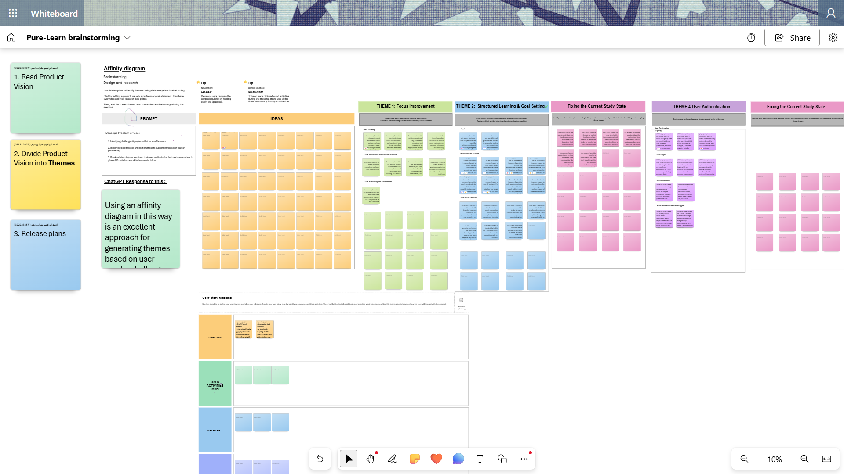

Slide 35
Themes
Extracting Themes from (Product vision, Personas & Scenarios, Prompt)
T# | Theme | Purpose
1 | Process & Structure | To provide a clear, step-by-step framework for learners to categorize their self-learning areas, setting general goals, organize their study plans, manage tasks, and track progress effectively.
2 | Problems & Challenges | Identify and address common obstacles that self-learners encounter, like distractions, (motivation, accountability, discipline) issues, and lack of structure.
3 | Best practices & Theories | Integrate effective learning theories and practices to enhance productivity, focus, and learning outcomes.
4 | Account Management | Manage user auth, settings, and data, providing a secure and personalized experience.
Notes:
Extracting Themes from (Product vision, Personas & Scenarios, Prompt)

Slide 36
Epics
Extracting Epics from Thems - Process & Structure Theme
E# | Epic | Description
1 | User Onboarding | Let user define himself, like his goals, education, job and so on. Why he wanna use this app ( select from suggestions reasons or he can add). Giving Quick App Tut.
2 | Goal Management | Allow users to set , adjust, and track their learningCategories (Categories is a group of goals, a name for area that he wanna work on like Self-Improvement, Software Engineering, etc..), goals, and tasks, learning resources, notes need to achieve this goals.
3 | Time Management | Provide tools for users to plan & schedule learning activities and set reminders to stay on track. Timers, focus sessiosns and so on.
Notes:
Extracting Themes from (Product vision, Personas & Scenarios, Prompt)

Slide 37
User Stories
Extracting Epics from Thems - Process & Structure Theme
Large Table will be Presented in Excel
Notes:
Extracting Themes from (Product vision, Personas & Scenarios, Prompt)

Slide 38
Top-Down Approach
Component |  |  |  |  | Component
U1 | U2 | U3 | U4 | U5 | U6 | U7 | U8 | U9 | U10 | U11 | U12 | U13 | U14 | U15 | U16 | U17 | U18 | U19 | U20 | U21 | U22 | U23 | U24
E1 |  |  | E2 |  |  | E3 |  |  | E4 |  |  | E5 |  |  | E6 |  |  | E7 |  |  | E8
TH1 |  |  |  |  |  | TH2 |  |  |  |  |  | TH3 |  |  |  |  |  | TH4
Product Vision
Notes:
Extracting Themes from (Product vision, Personas & Scenarios, Prompt)

Slide 39
4. Analysis
More brainstorming & User stories refinement to develop the technical solution from the theoretical solution

Slide 40
Extracting Components from user stories

Slide 41
Make mind maps to group components with the same context.

Slide 42
Make mind maps to group components with the same context.

Slide 43
5.1. Software Architecture

Slide 44
C4 Model
C4 vs UML - Why use it
Notes:
Over Engineering

Slide 45
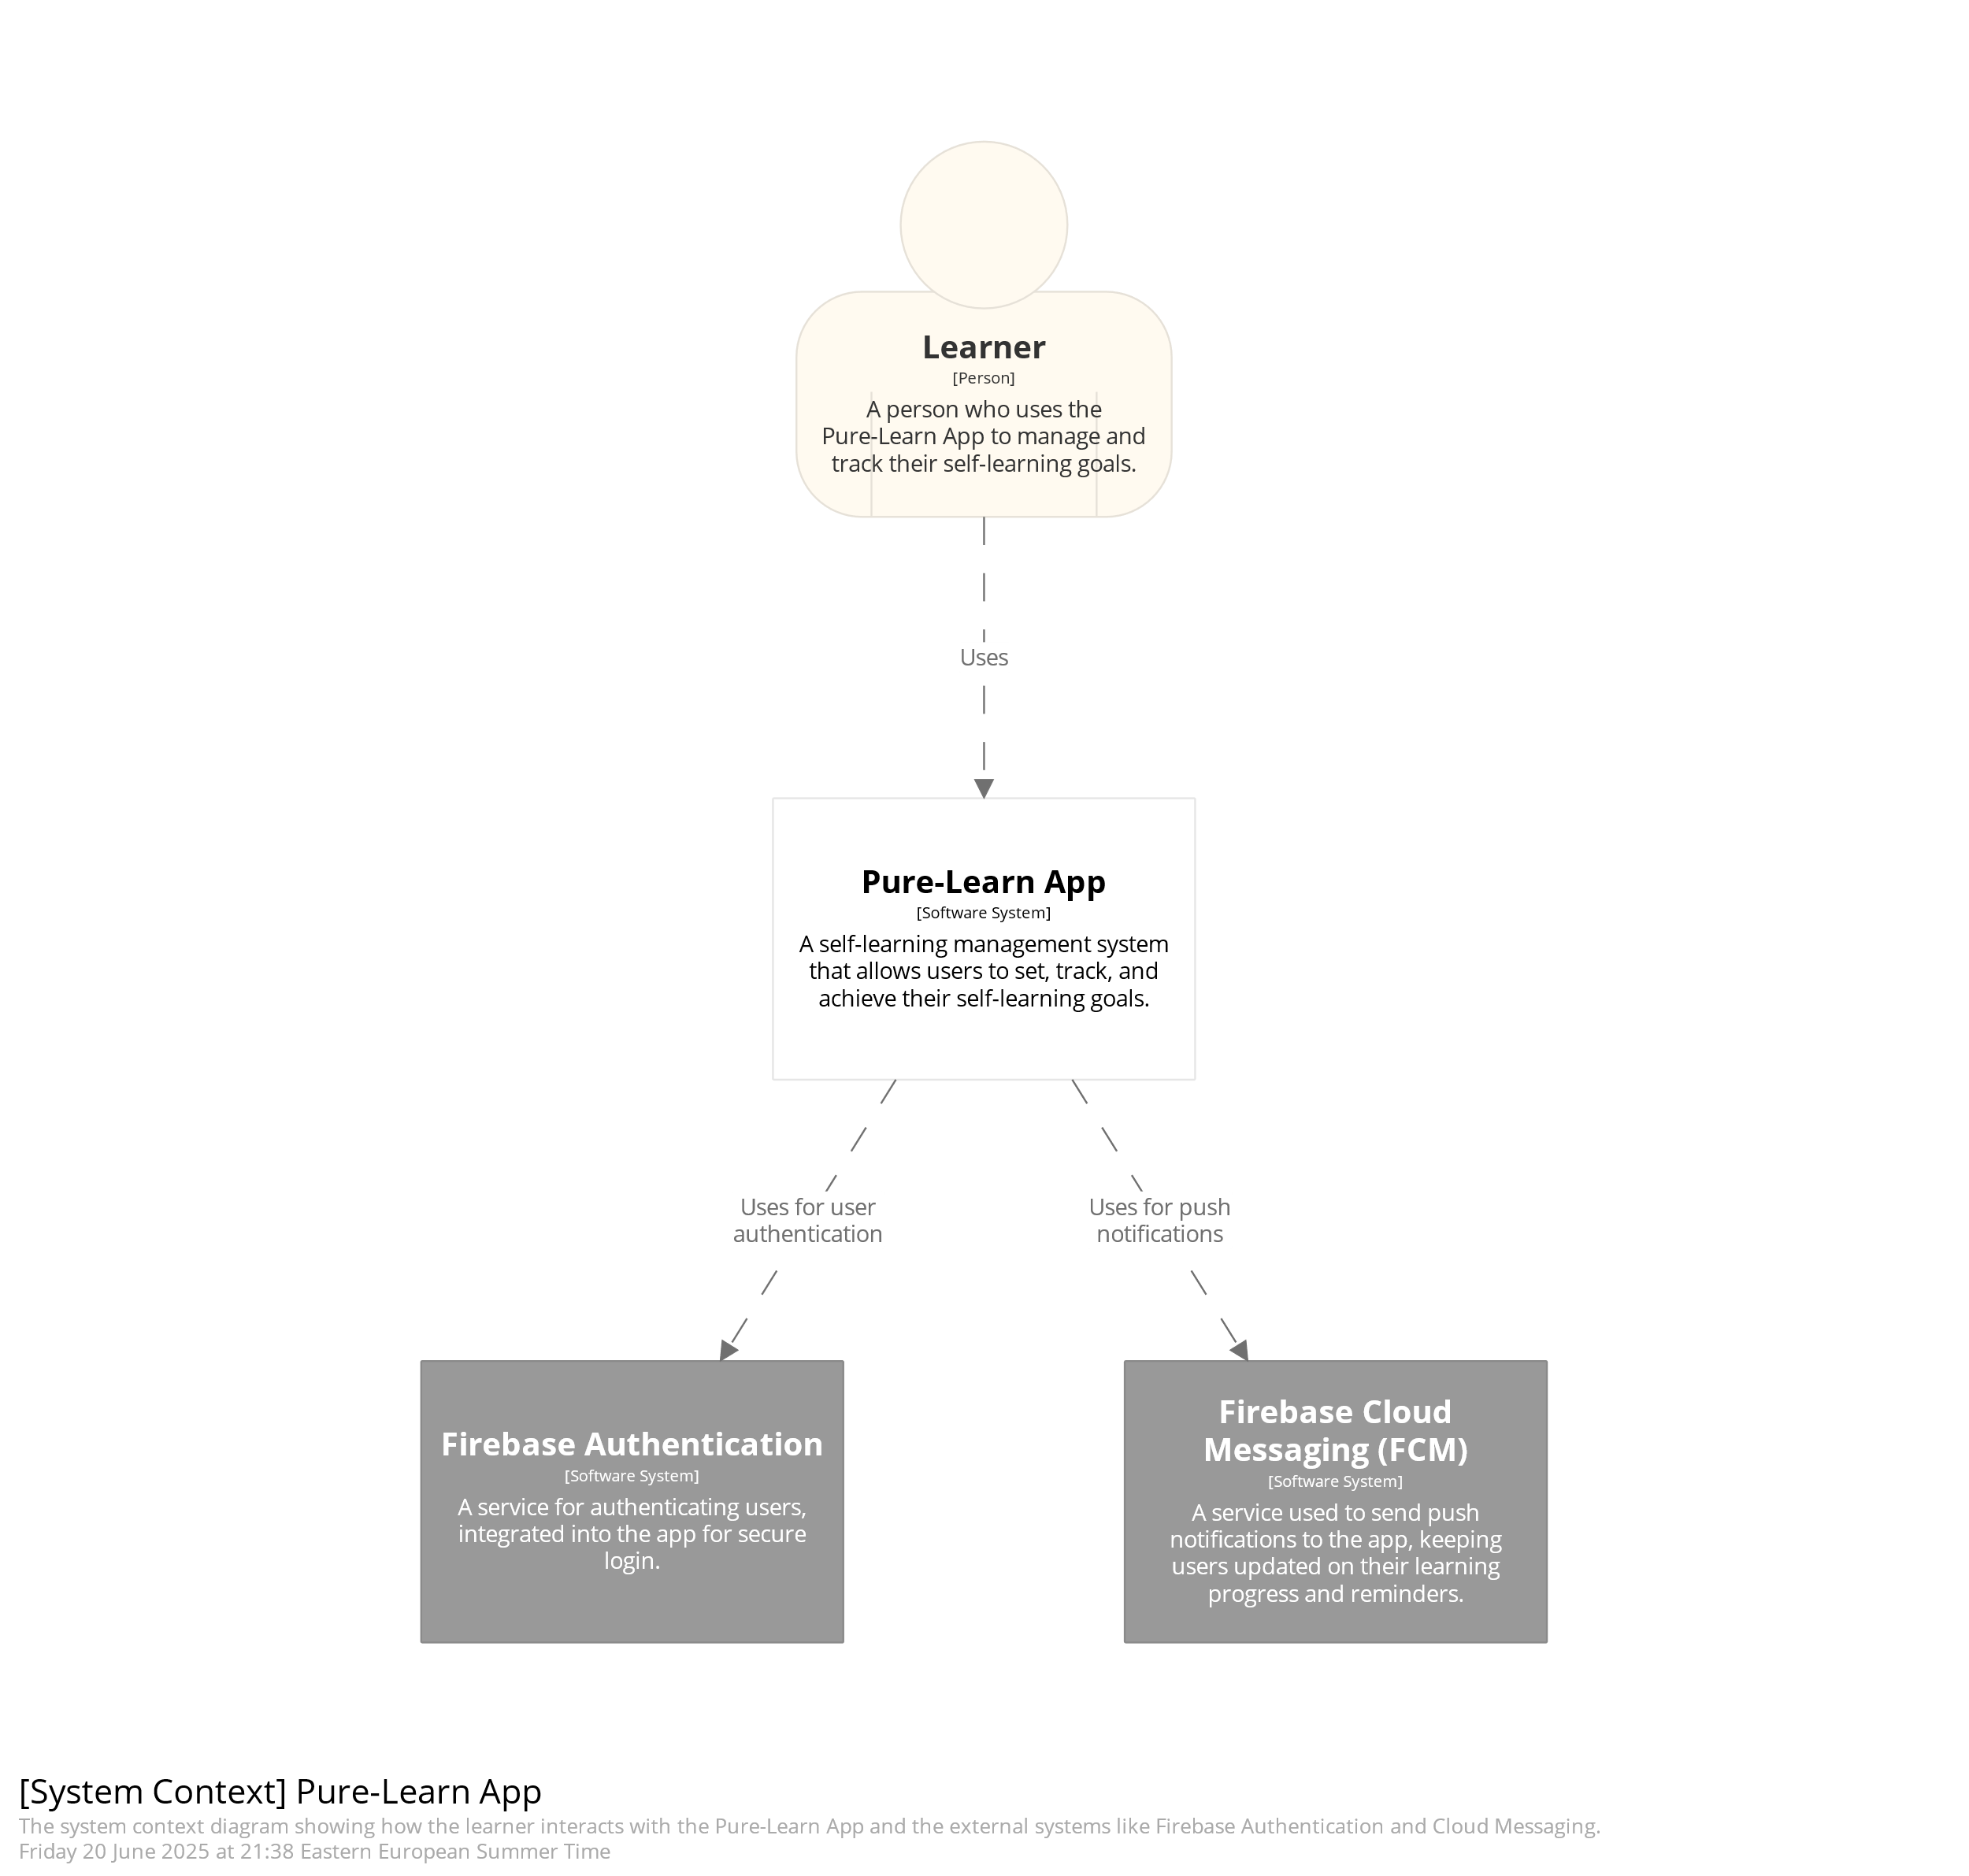

Slide 46
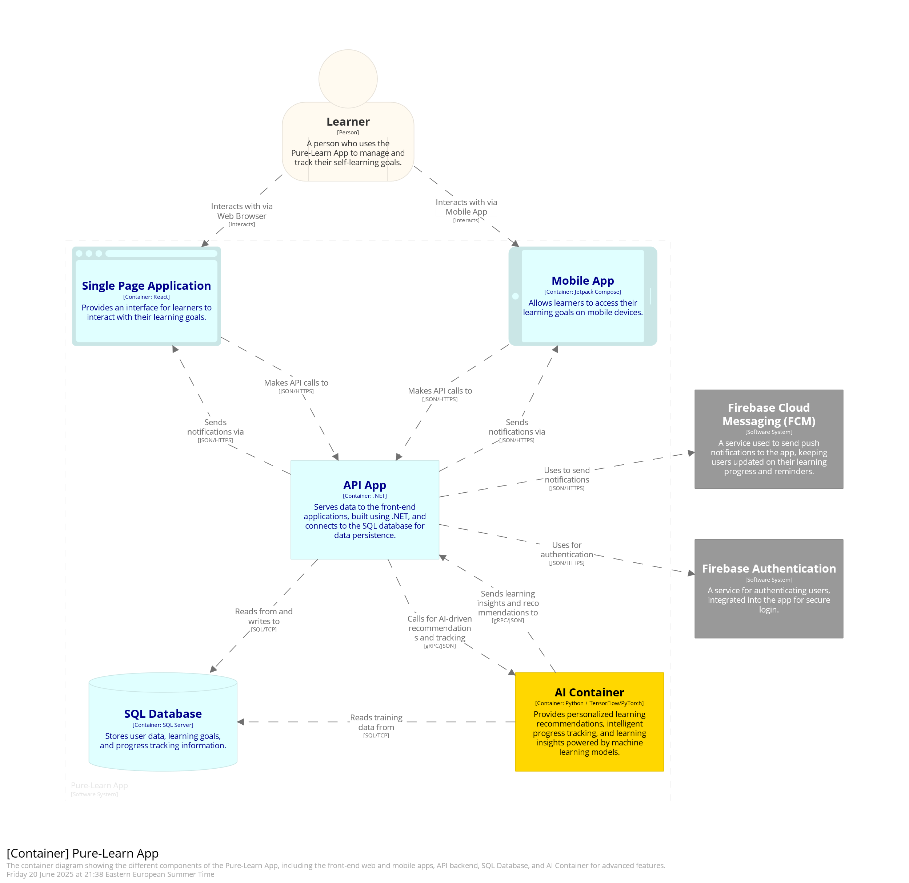

Slide 47
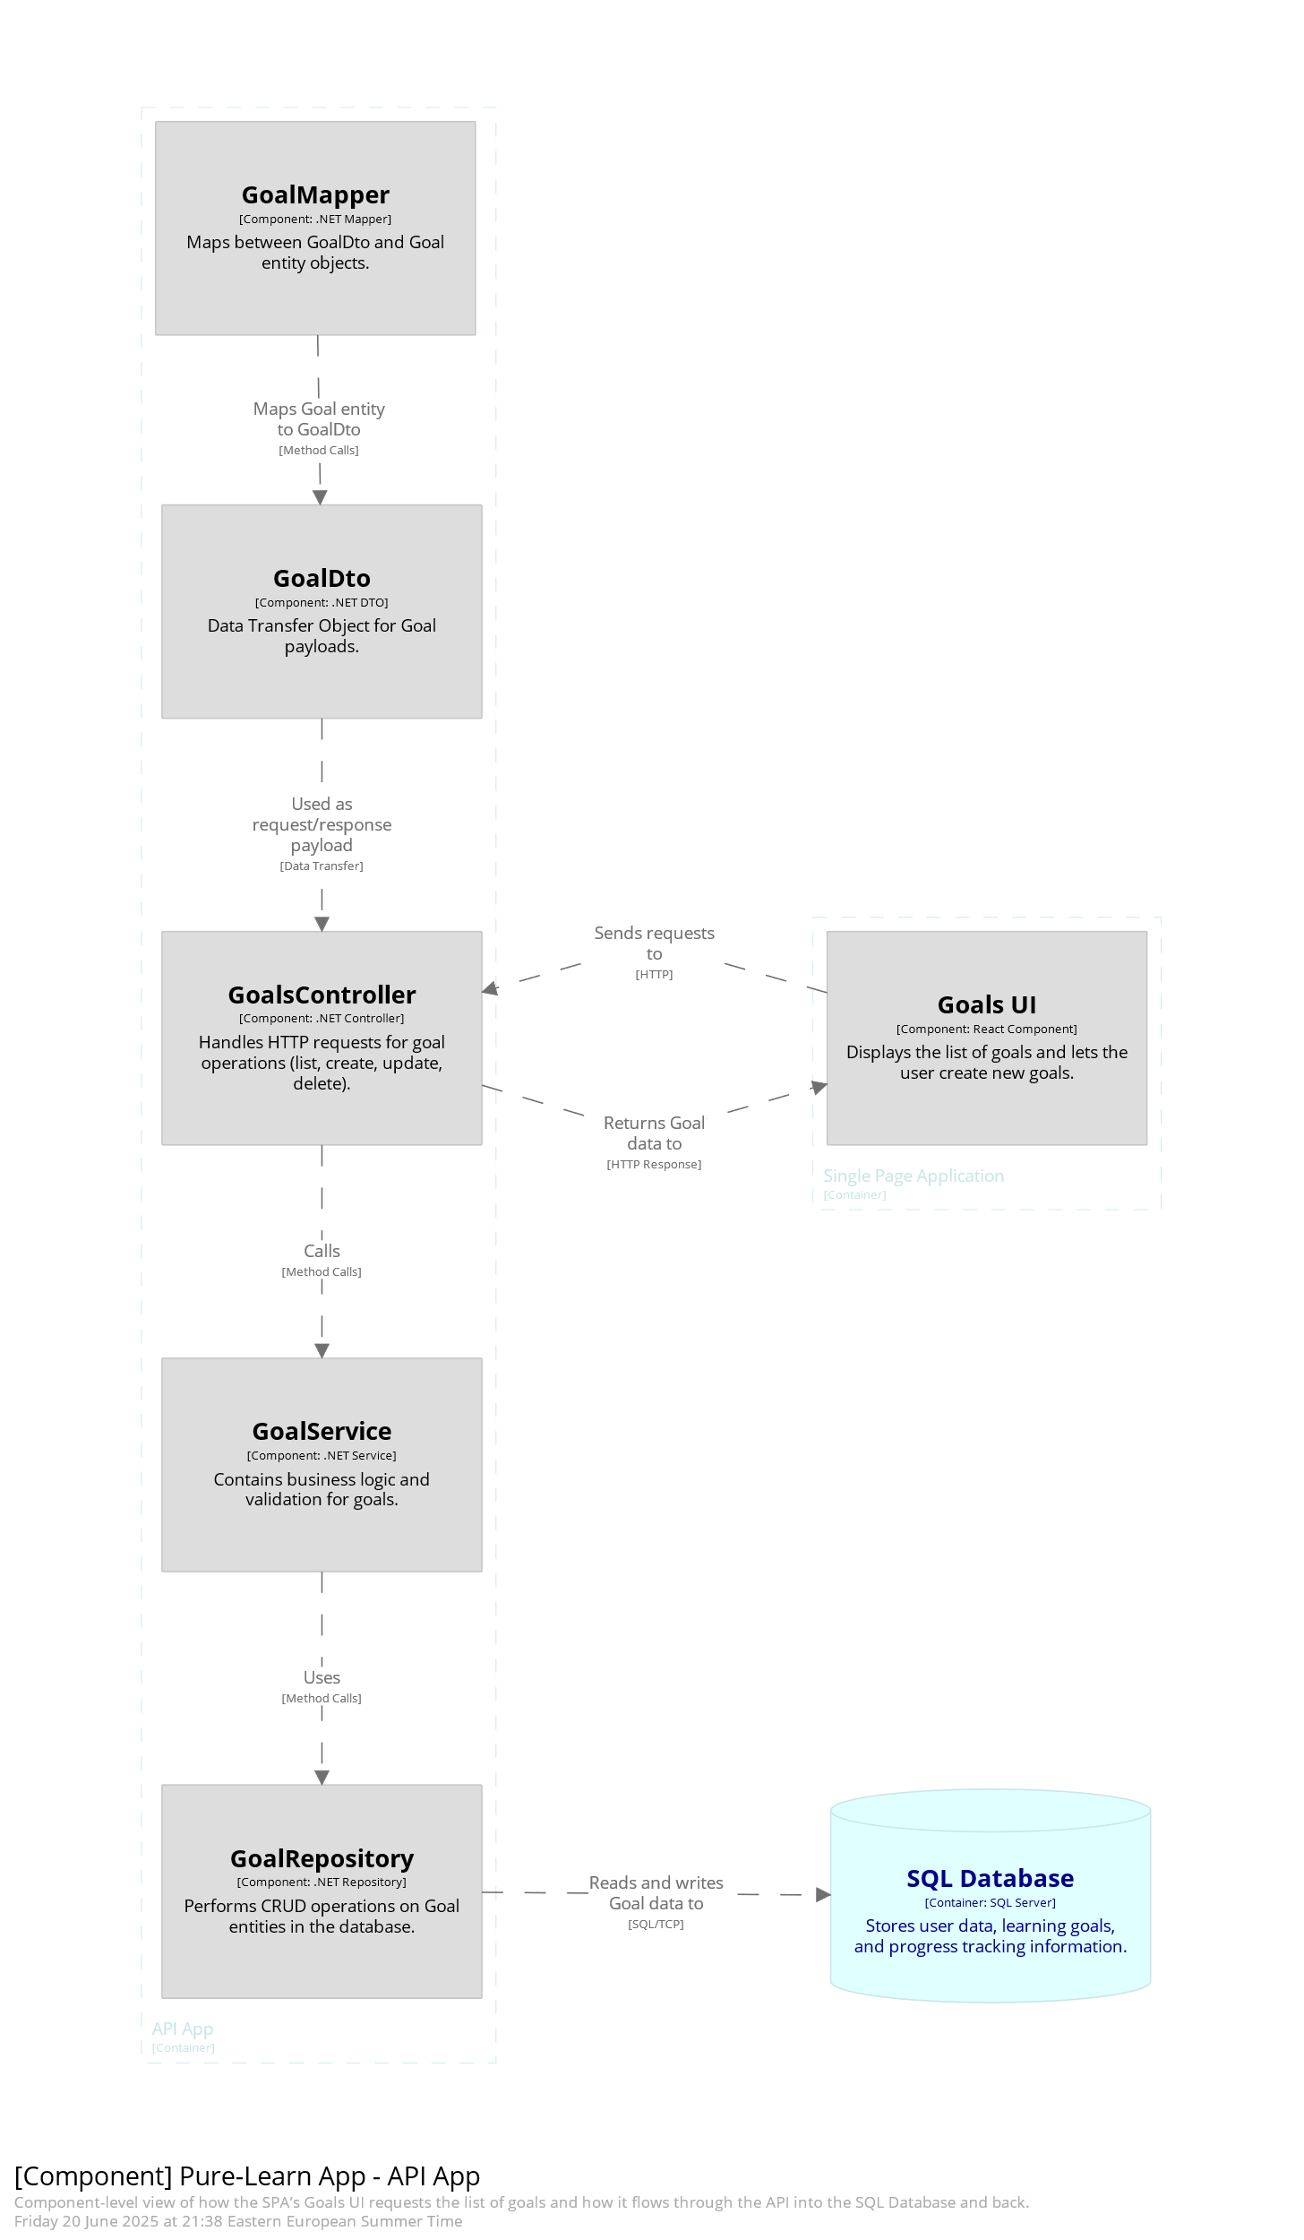

Slide 48
5.2. DB Scheme

Slide 49
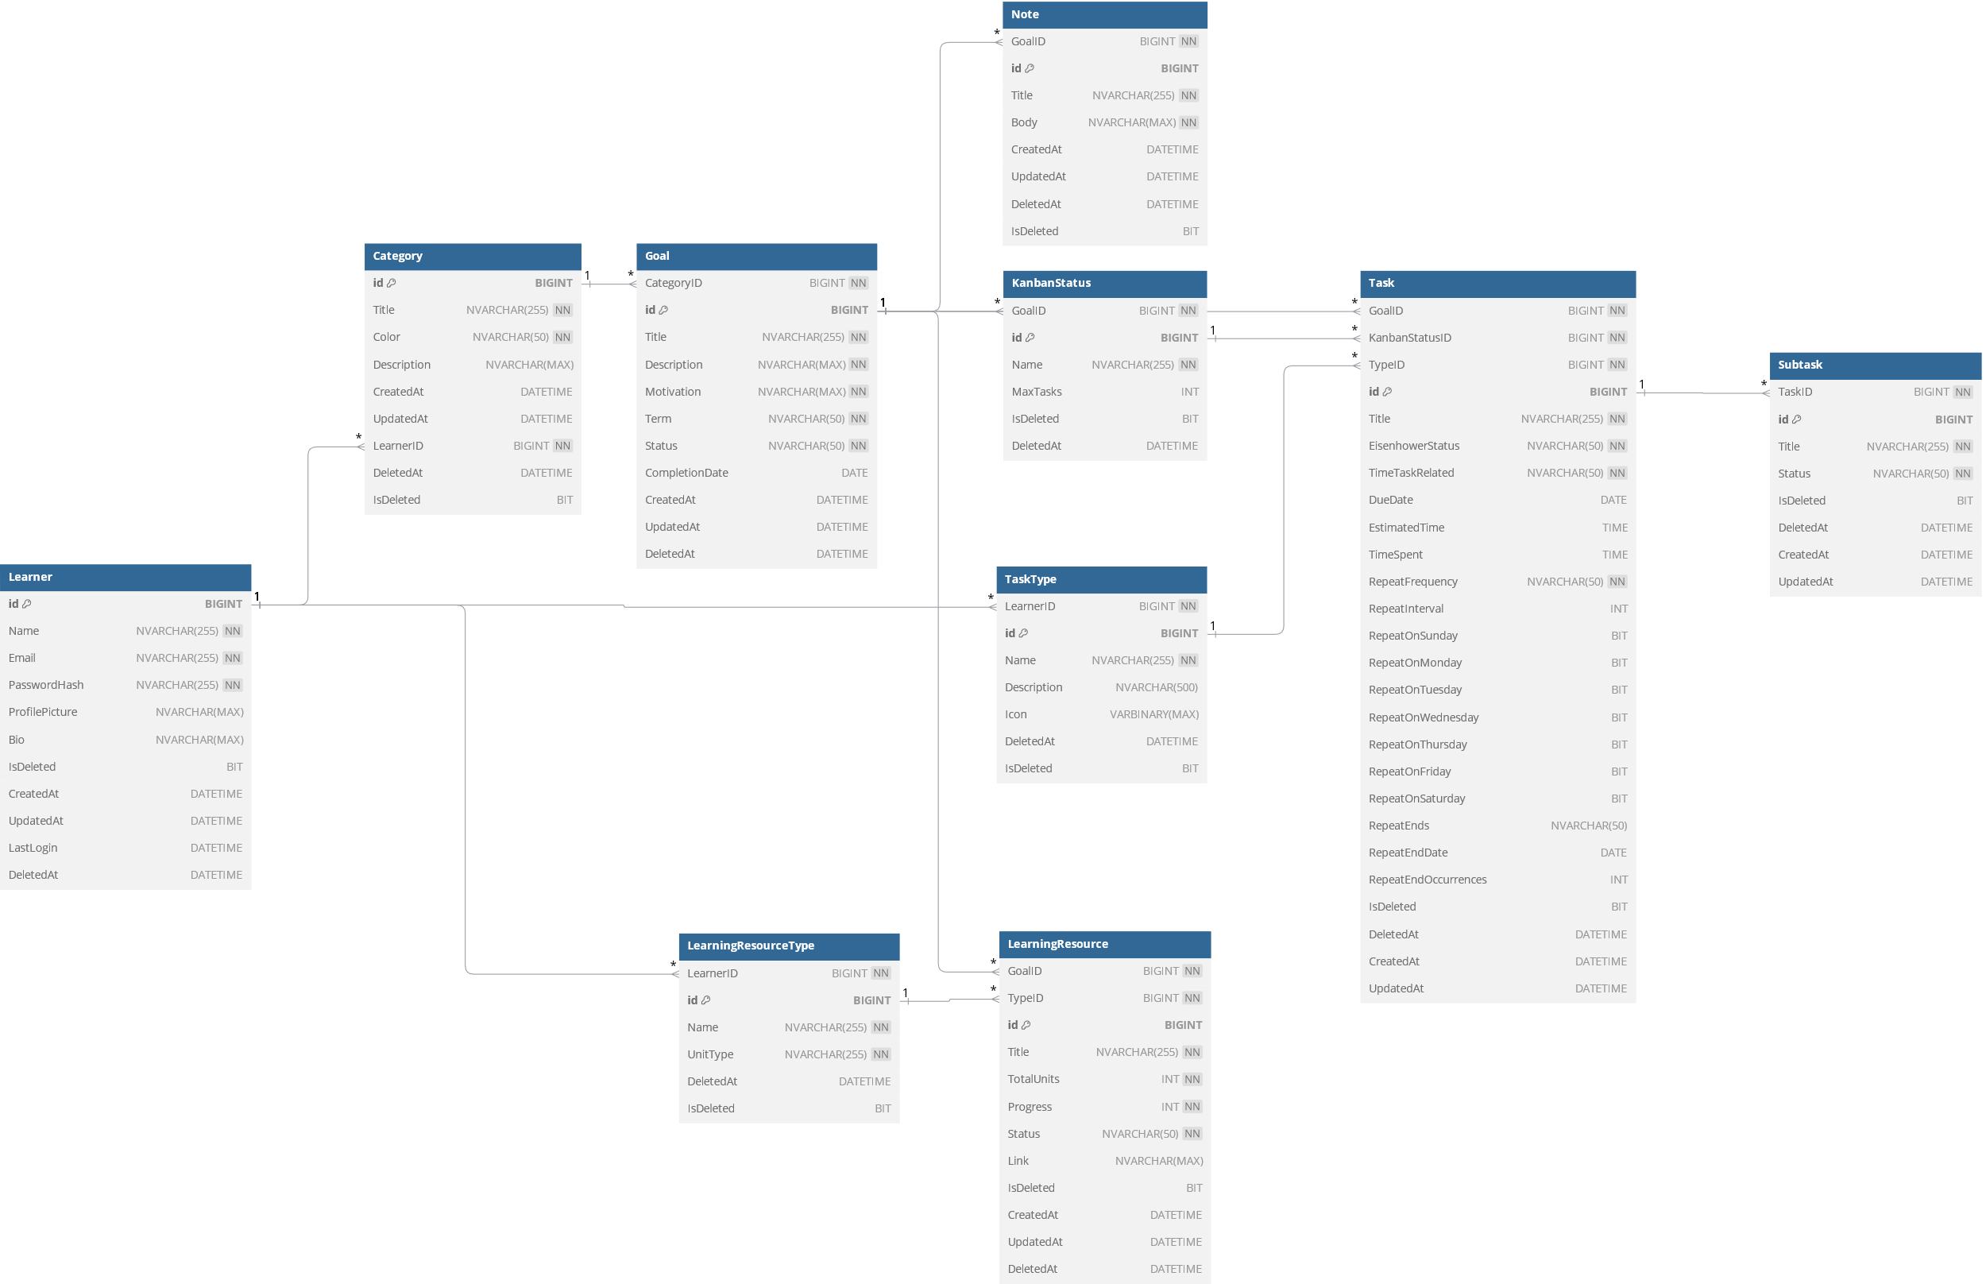

Slide 50
4. Development

Slide 51
4. 1. DB Development
Tools:
Build.AI
VSCode SQLSERVER Extension:
For DB Management
VSCode Database Project: For
version control, managing schema changes, and syncing with the database.

Slide 52
4. 2. API Development

Slide 53
DTOs

Slide 54
Mappers

Slide 55
Repositories Interface

Slide 56
Repositories

Slide 57
Controllers

Slide 58
Dependencies Injection in program.cs file

Slide 59
Containerization

Slide 60
4.3. UI Design
Go to Figma

Slide 61
Frontend Implementation

Slide 62
DEPLOYMENT
Free service monthly limited hosting
100$ credit for students
Database Deployment
Azure SQL Database (Serverless)
API Deployment
Azure App Service
CD/CI Pipelines
GitHub action
Script

